Slide 1
MDIRA Profile Supplement Diagrams
(For Use in IHE DEV MDIRA Profile Documents & Confluence Pages)

Slide 2


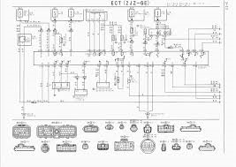



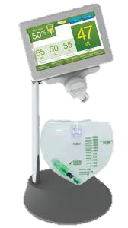
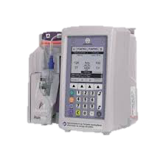
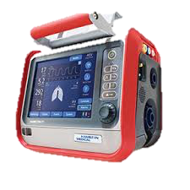

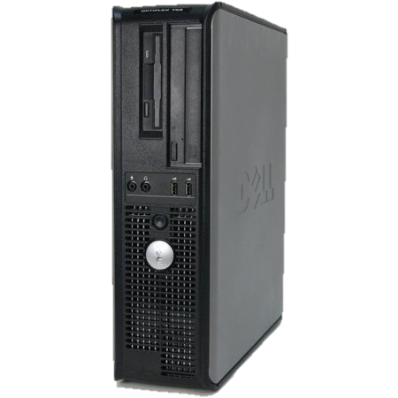
MDIRA Role in System Development
2021.04.21A
Requirements & Guidance for:
Interoperability
Security
Modularity
Functionality
Implementation
Etc.
MDIRA-enabled Heterogeneous Decoupled Ecosystem of Plug-and-Trust SES MDI Products!
MDIRA
Specifications
ISO/IEEE 11073 SDC Standards
IHE SDPi Profiles
IHE MDIRA Profiles
…
System Requirements
& Architecture
Operational
Requirements
& Concept
MDIRA Reference Implementations
IHE MDIRA / SDPi Implementations
…
Design
Specifications
System
Implementation
Industry Standards and Guidance
An Autonomous
Medical
Care System

Slide 3
MDIRA Actor Diagram
2021.03.26A
MDIRA Component {abstract}
Non-MDIRA Equipment
MDIRA
Supervisor
MDIRA User Manager
MDIRA
Data Logger
MDIRA Connector {abstract}
Multi-Patient Remote Monitoring
MDIRA Device Adaptor
Multi-Patient Data Repository
MDIRA FHIR Gateway
MDIRA
Medical System
MDIRA
Patient Care Platform
MDIRA
Equipment
MDIRA
Medical App
Evacuation Vehicle
NOTE: MDIRA RI Systems (e.g., Therapy Coordinator SAMD) would be discussed in the Use Case / application sections.

Slide 4
SDPi-P Actor Diagram
2021.02.18A
SOMDS Participant (Abstract)
SOMDS Connector (abstract)
Non-SOMDS Systems
SOMDS
Provider
(MDIB, Services, …)
SOMDS FHIR Gateway
SOMDS Consumer
(consume MDIB info, invoke services, …)
SOMDS V2 Gateway
SOMDS Sensor Gateway
SOMDS Smart App Platform
Smart Apps
(incl. SAMD)

Slide 5
MDIRA Actor Diagram
2021.02.17A
MDIRA Component (abstract)
Non-MDIRA Equipment
MDIRA
Supervisor
MDIRA User Manager
MDIRA
Data Logger
MDIRA Connector (abstract)
Multi-Patient Remote Monitoring
MDIRA Device Adaptor
Multi-Patient Data Repository
MDIRA FHIR Gateway
MDIRA
Medical System
MDIRA
Patient Care Platform
MDIRA
Equipment
MDIRA
Medical App
Evacuation Vehicle
NOTE: MDIRA RI Systems (e.g., Therapy Coordinator SAMD) would be discussed in the Use Case / application sections.

Slide 6
MDIRA Actor Diagram
2021.02.09B
MDIRA Component (abstract)
MDIRA
Supervisor
MDIRA User Manager
MDIRA
Data Logger
MDIRA Connector (abstract)
Non-MDIRA Equipment
MDIRA Device Adaptor
Multi-Patient Data Repository
MDIRA FHIR Gateway
MDIRA
Medical System
MDIRA
Patient Care Platform
MDIRA
Equipment
MDIRA
Medical App
Evacuation Vehicle
NOTE: MDIRA RI Systems (e.g., Therapy Coordinator SAMD) would be discussed in the Use Case / application sections.

Slide 7
MDIRA RI Examples
2021.01.28A

Slide 8
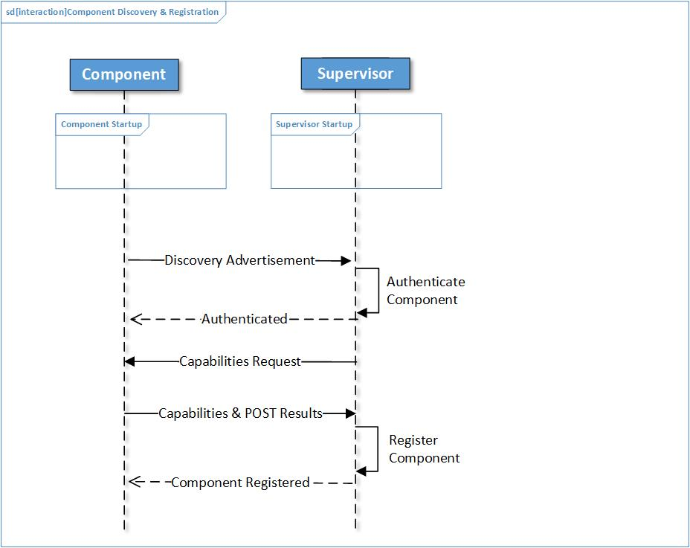
MDIRA 2.0 Examples
2021.01.28A
From 2.0 spec. Figure A-1 Component Discovery, Authentication & Registration

Slide 9
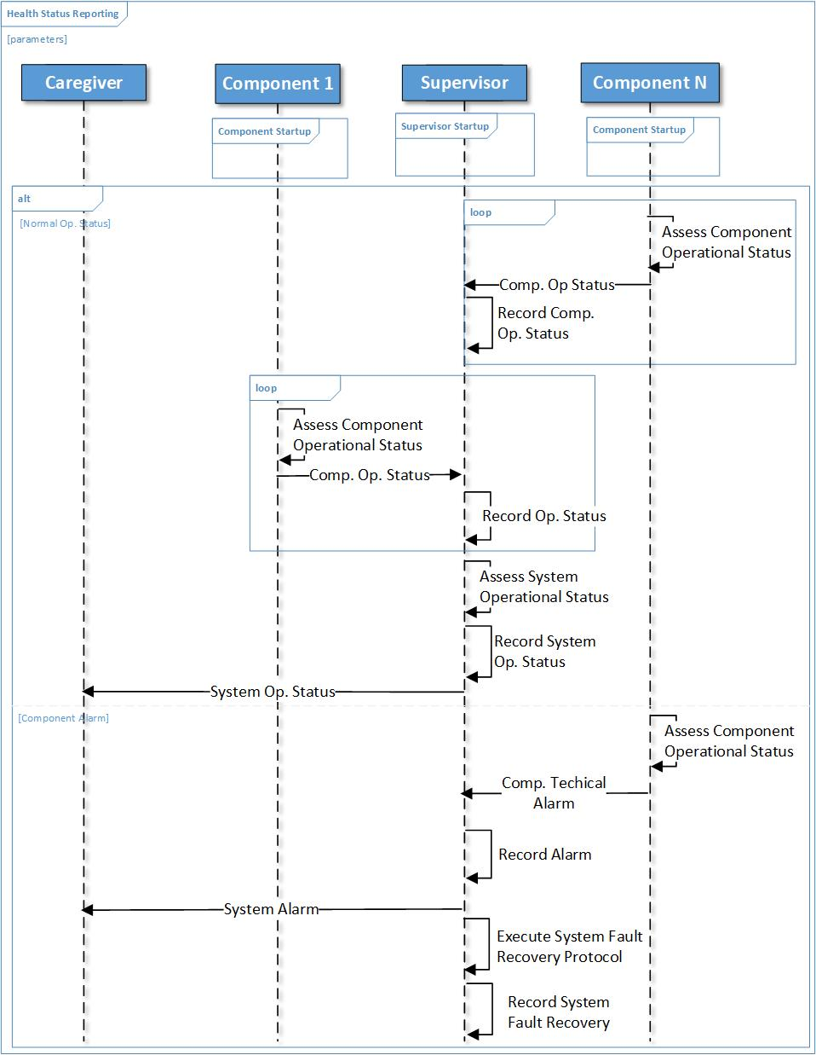
MDIRA 2.0 Examples
2021.01.28A
From 2.0 spec. Figure A-2 MDIRA Component Health and Status Reporting

Slide 10
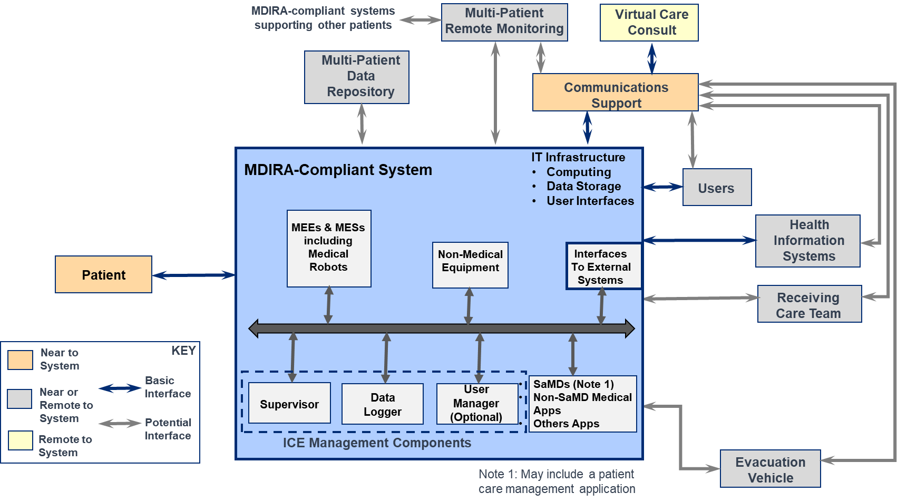
MDIRA Components Diagram
2021.01.22A
Source: MDIRA 2.0 (draft)

Slide 11
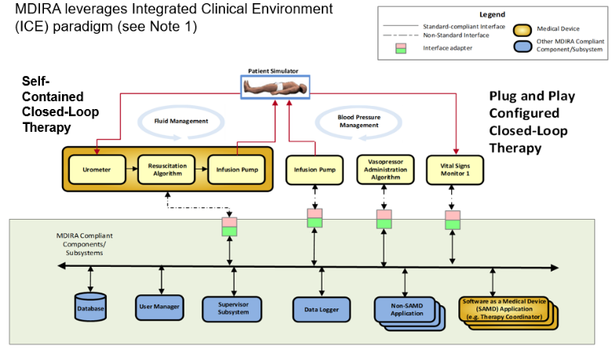
MDIRA SDC Ref. Implementation Diagram
2021.01.22A
Source: IHE DEV “MDIRA Brief Profile Proposal”, 2020.09.

Slide 12
Diagram Archive & Stuff

Slide 13
MDIRA Actor Diagram
2021.02.18A
MDIRA Component (abstract)
Non-MDIRA Equipment
MDIRA
Supervisor
MDIRA User Manager
MDIRA
Data Logger
MDIRA Connector (abstract)
Multi-Patient Remote Monitoring
MDIRA Device Adaptor
Multi-Patient Data Repository
MDIRA FHIR Gateway
MDIRA
Medical System
MDIRA
Patient Care Platform
MDIRA
Equipment
MDIRA
Medical App
Evacuation Vehicle
NOTE: MDIRA RI Systems (e.g., Therapy Coordinator SAMD) would be discussed in the Use Case / application sections.

Slide 14
MDIRA Actor Diagram
2021.01.28A
MDIRA Component (abstract)
MDIRA
Supervisor
(…)
MDIRA User Manager
(optional)
MDIRA
Data Logger
(…)
MDIRA Connector (abstract)
Non-MDIRA Equipment
MDIRA Device Adaptor
Multi-Patient Data Repository
MDIRA xyz Gateway
MDIRA
Medical System
(MEE/MES)
MDIRA
Medical App
(incl. SAMD)
MDIRA
Equipment
(non-medical)
NOTE: MDIRA RI Systems (e.g., Therapy Coordinator SAMD) would be discussed in the Use Case / application sections.

Slide 15
MDIRA Actor Diagram
2021.01.22A
MDIRA Component
MDIRA ICE Management Component
MDIRA Connector
MDIRA
Supervisor
(…)
MDIRA User Manager
(optional)
MDIRA
Data Logger
(…)
MDIRA Device Adaptor
External Equipment
Multi-Patient Data Repository
MDIRA xyz Gateway
MDIRA
Medical System
(MEE/MES)
MDIRA
Medical App
(incl. SAMD)
MDIRA
Equipment
(non-medical)
NOTE: MDIRA RI Systems (e.g., Therapy Coordinator SAMD) would be discussed in the Use Case / application sections.

Slide 16
SDPi-P Actor Diagram
2020.08.28A
SOMDS Participant
SOMDS Connector
Non-SOMDS Systems
SOMDS
Provider
(MDIB, Services, …)
SOMDS FHIR Gateway
SOMDS Consumer
(consume MDIB info, invoke services, …)
SOMDS V2 Gateway
SOMDS Sensor Gateway
SOMDS Smart App Platform
Smart Apps
(incl. SAMD)

Slide 17
SDPi-R Actor Diagram
2020.09.11A
SOMDS Consumer
SOMDS
Medical Data Consumer
DEV-AA
SOMDS
FHIR Medical Data Gateway
FHIR-based Profile Actors / Systems / Applications
DEV-CC
DEV-BB
SOMDS FHIR Gateway
DEV-AA Establish Medical Data Exchange
DEV-BB Publish Medical Data
DEV-CC Retrieve Medical Data
DEV DEC Device Observation Reporter
SOMDS
DEC Gateway
DEV-01
SOMDS
Provider
SOMDS
Medical Data Provider
DEV-AA
DEV DEC Device Observation Consumer
DEV-CC
DEV-01
DEV-BB
SOMDS V2 Gateway

Slide 18
SDPi-A Actor Diagram
2020.09.15A
SOMDS Consumer
SOMDS
Medical Alert Consumer
DEV-AA Establish Medical Alert Exchange
DEV-BB Publish Medical Alert Update
DEV-CC Retrieve Medical Alert Status
DEV-DD Manage Medical Alert Delegation
DEV-EE Delegate Medical Alert
DEV-FF Update Alert Acknowledgement Status
DEV-AA
SOMDS
ACM Gateway
DEV-04
DEV ACM
SOMDS
Provider
SOMDS
Medical Alert Provider
DEV-CC
DEV-FF
DEV-04
DEV-BB
DEV-05
SOMDS V2 Gateway

Slide 19
SDPi-xC Actor Diagram
2020.09.11A
SOMDS Consumer
SOMDS
Medical Control Consumer
DEV-AA Manage Medical External Control
DEV-BB Invoke Medical Control Services
SOMDS
Provider
SOMDS
Medical Control Provider

Slide 20
SDPi-P Content Actor Diagram
2020.08.12A
Provide Content
BICEPS
Content
Creator
BICEPS
Content
Consumer

